Slide 1

Social Software: Groups with a Goal

Slide 2
The Politics of Groups
If a group has a goal, how can we understand the way the software supports that goal?
This is a complicated question, not least because the conditions that foster good group work, such as clear decision-making process, may well upset some of the individual participants.
Most of our methods for soliciting user feedback assume, usually implicitly, that the individual's reaction to the software is the critical factor.
This tilts software and interface design towards single-user assumptions, even when the software's most important user is a group.
Clay Shirky Social Software and the Politics of Groups

Slide 3
All Social Software is for Groups
But not always Groups with a Goal
Weblogs: Often “Individuals with an Attitude”
  Championing each personal voice
  Conversing publicly, by citing each others writings
  Creating streams of thought and opinion that can be aggregated, bottom up
  Organized by Author over Time

Slide 4
Enterprise Weblog
Organized by Group, then Time
Each Group has members and permissions, and a shared project space
Provides easy ways for individuals to create, comment on, and link content within or across more public or more private spaces
Individuals see the union of all conversations and activity, organized by project, importance and time – like a newspaper

Slide 5
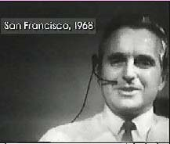
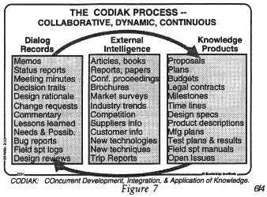
Inspired by: Doug Engelbart on Creating High Performance Teams

Slide 6
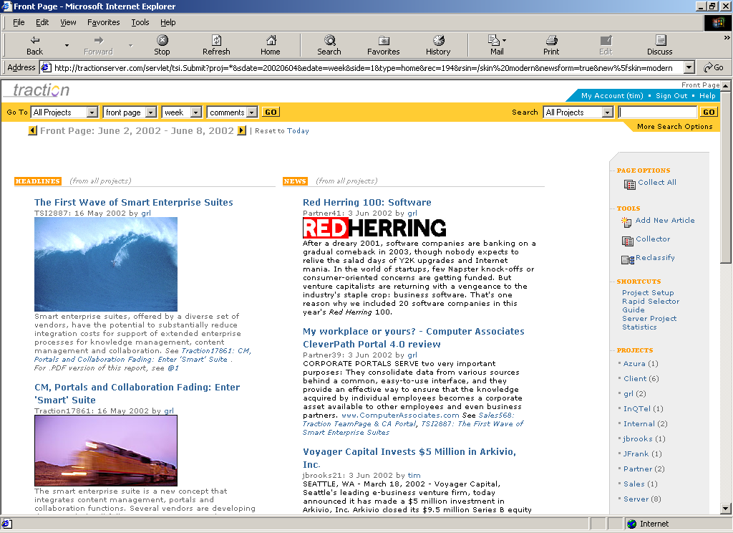
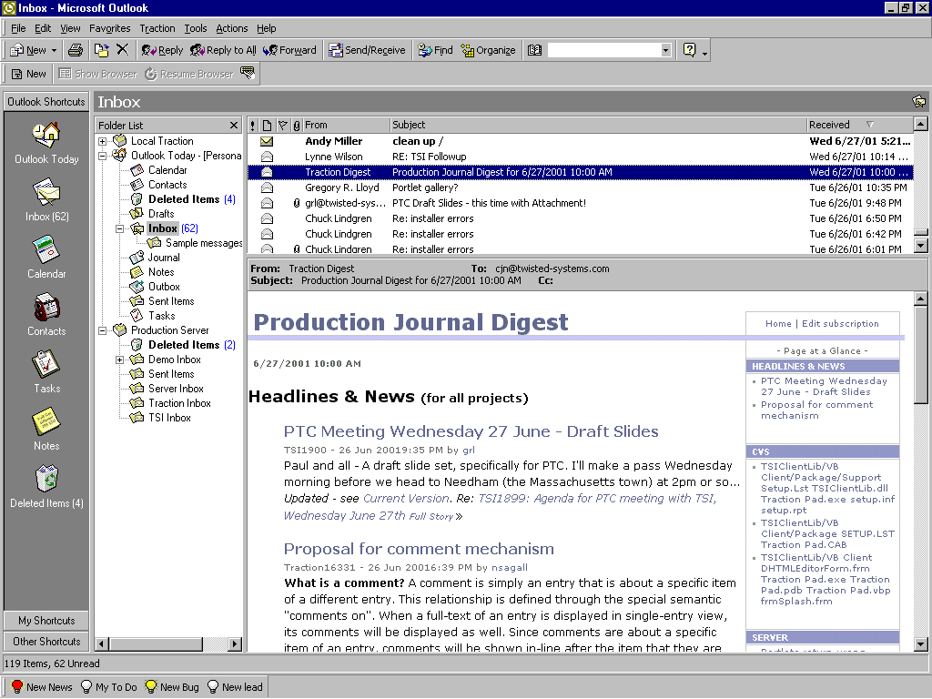
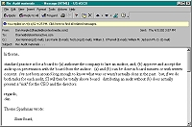
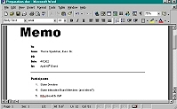
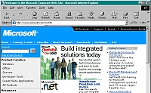
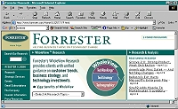
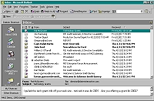
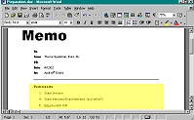
Traction TeamPage
Enterprise Weblog
Discover and Collect
Connect
from Email
Web Content
TeamPage
Microsoft Office
Email Newsletter
+ other sources
Intranet
Email
Traction Creates

Slide 7
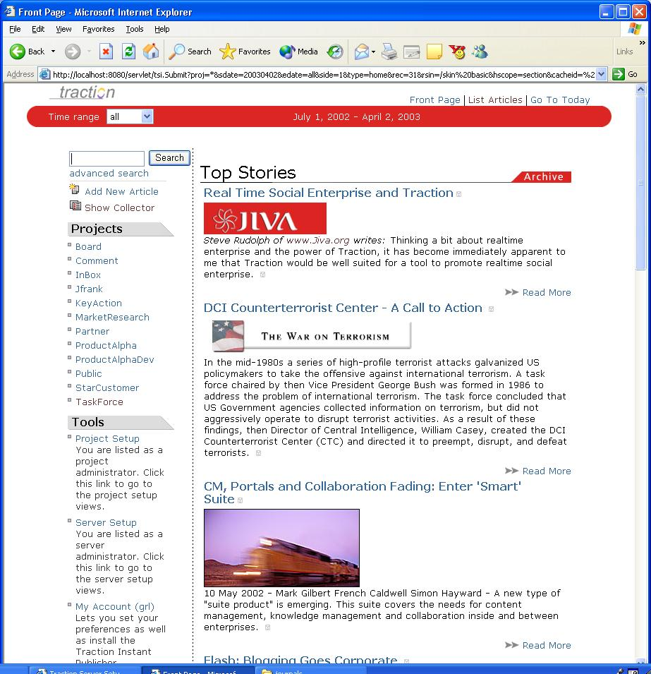
Front Page
Top stories across all Projects – for the selected period of time: day, week, month, quarter, year
For Projects where you have read permission
Can include your personal weblog Project
Click a Project name to dive into that particular space
Or, type a word or phrase in the search box
Or, click to the next or previous time period

Slide 8
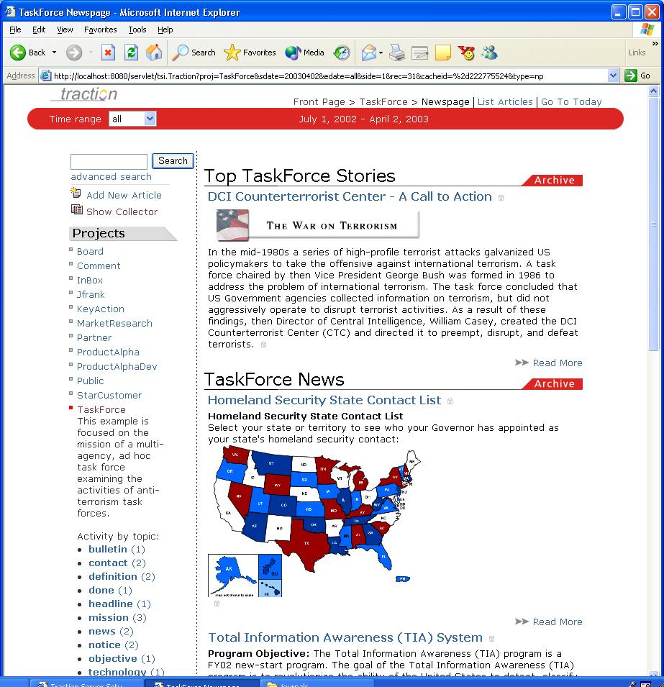
TaskForce Newspage
Projects have labels that flag:
Topics of interest (for that Project)
Action items
Important items, which float up to the Front Page
Click any label to see articles or paragraphs that have that label attached
Zoom into the TaskForce project, which has its own Section under the Front Page.
Click any title to dive in, or …

Slide 9
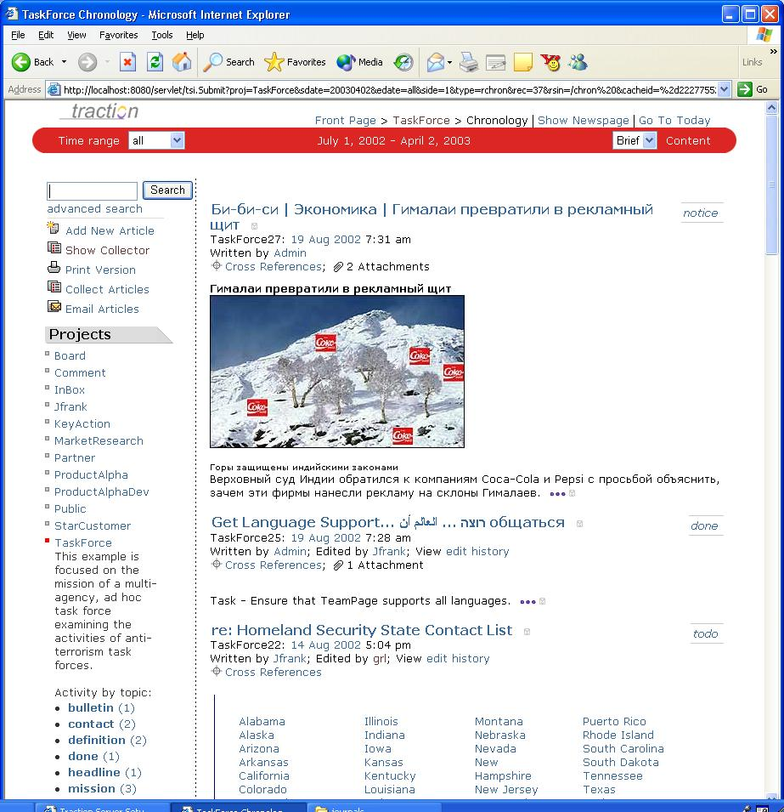
List Articles
Click List Articles to see a chron list of articles and comments, most recent first.
Click any title to dive in …

Slide 10
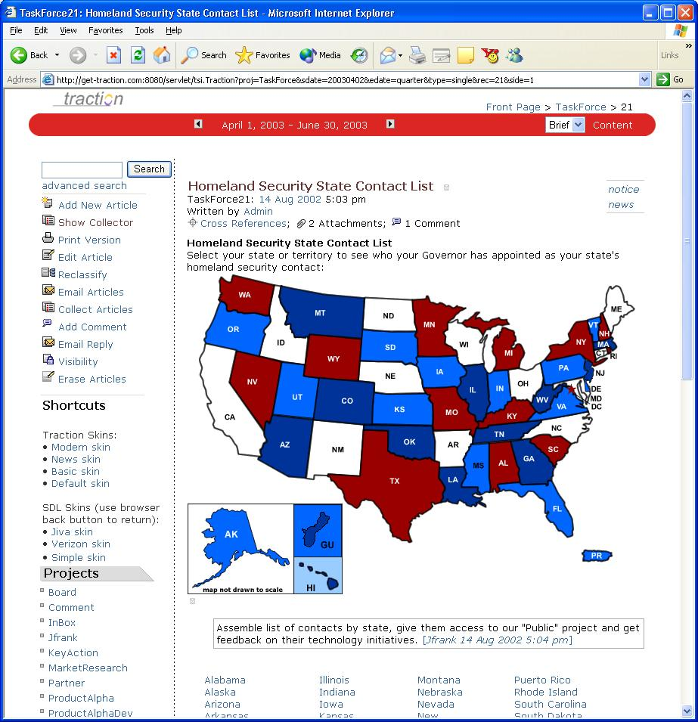
Single Article
Edit, email out, collect, add / remove labels, or click to add a comment after any paragraph
Traction shows a cross-reference summary of all article connected to this one
You can record your comment in the TaskForce project.
Or, any other project you are allowed to write to.
For example: Board of Directors, personal notebook

Slide 11
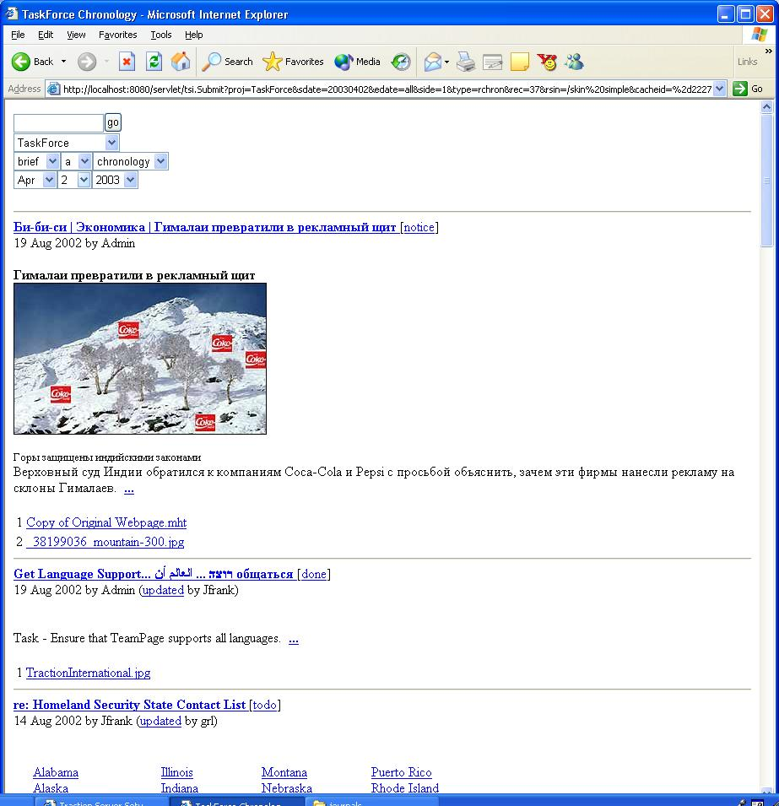
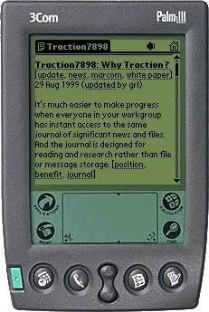
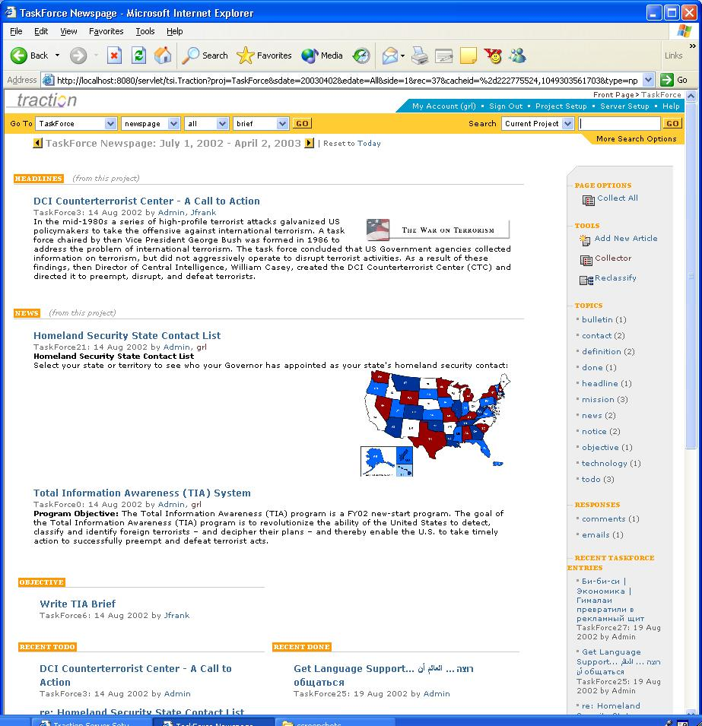
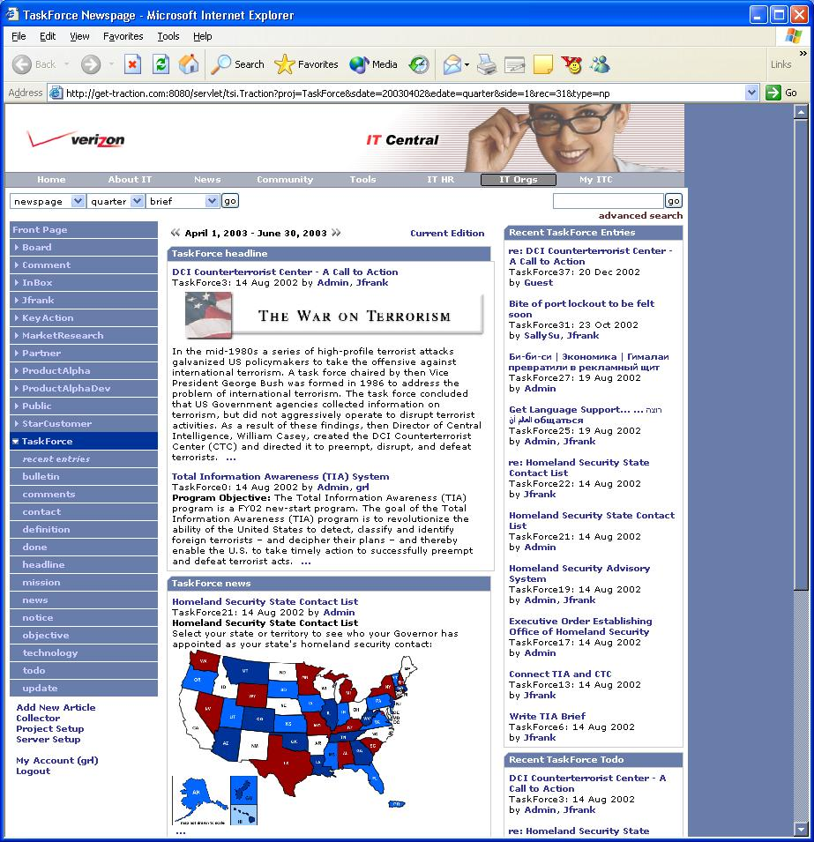
Traction Skins deliver the same content using different HTML or XML templates - simultaneously

Slide 12
Result
Each Project space becomes a Place with its own team and audience
Project spaces can be opened up to a wider group of peers or senior management, or kept private
Each Project space can have its own norms, with comments made to any selected audience simultaneously

Slide 13
Intelligence
Collect and link information from all sources: web, email, office documents
Maintain personal analyst notebooks, internal analysis, and external client areas as separate spaces
Label items for publication to a wider group
Automate distribution of a email daily digest, as well as maintain a reference web site with its own deep archive.
Collect and respond to inline comments and questions from both internal and external readers

Slide 14
Program Management
Create separate spaces for PMO coordination with each contractor + shared space for for the extended team + PMO private space(s)
  PMO sees the union of all contractor spaces, plus extended team space, plus PMO private space
  Contractors see their own space plus extended team space
  All contractors + PMO can see and comment on extended team space, with comments directed to any space for which they have write permission

Slide 15
Ops Log
Create one or more skins designed explicitly for warfighter / first responder use:
  Clear, simple direct design
  Careful layout, minimal graphics for handheld use with low bandwidth links
  Present information in context with quick click links for supporting or related material
Support staff can use high bandwidth design to respond to field requests, for one or more ops teams simultaneously
Provide XML feeds into and out of the Ops Log

Slide 16
Traction Technology
Scalable, XML-based Java server
Works with POP or IMAP mail servers
Integrates using standard Web services
Lightweight plug-ins for easy collection from Microsoft Internet Explorer, Office, and other apps.
Java Software Developers Kit (SDK) exposes deep and elegant hypertext journaling engine
Skin Definition Language (SDL) allow rapid creation and deployment of skins with only HTML tools.
Installs and deploys the same day

Slide 17
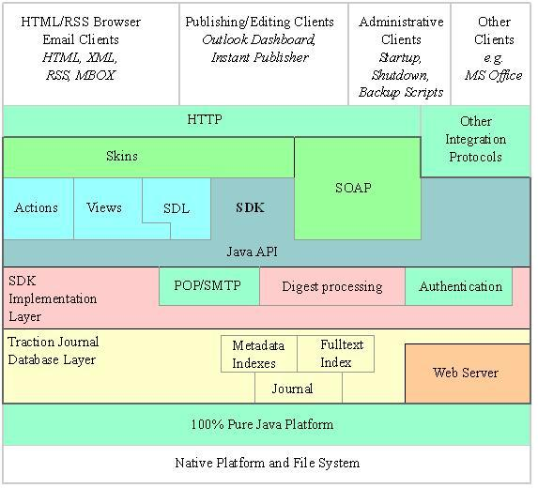
Traction Architecture

Slide 18
Traction Summary
An enterprise weblog
  A time ordered working communication hub
  Supports research, analysis, and conversation within and across permissioned spaces
A layer over email and the web
  Collecting and linking information from siloed sources that people use every day
A highly adaptable front end for
  Logging, tracking and reporting all forms of working communication
  From automated sources, as well as people

Slide 19
References
NLS TELECONFERENCING FEATURES: The Journal, and Shared-Screen Telephoning, Douglas C. Engelbart, Compcon 75 Digest, Sep 1975 pp 173-178 (AUGMENT,33076)
Toward High-Performance Organizations: A Strategic Role for Groupware, Douglas C. Engelbart, Bootstrap Institute, June 1992 (AUGMENT,132811)
Keeping it Simple: Investigating Resources in the Periphery, John Seely Brown and Paul Duguid, in Bringing Design to Software, Terry Winograd editor, ACM Press 1996
The Social Life of Documents, John Seely Brown and Paul Duguid, First Monday, Vol. 1, No. 1, May 6 1996
Re-Place-ing Space: The Roles of Place and Space in Collaborative systems, Steve Harrison and Paul Dourish, Proceedings of CSCW '96
Information Foraging, Peter Pirolli and Stuart K. Card, Psychological Review, 1999
Social Software and the Politics of Groups, Clay Shirky, www.shirky.com, 3 March 2003

Slide 20

Contact
Greg Lloyd, President
grl@tractionsoftware.com
(401)-528-1145
Traction Software, Inc.
245 Waterman Street
Suite 309
Providence, RI 02906
www.TractionSoftware.com

Slide 21
Example
How Traction TeamPage supports the Competitive Intelligence Process:
  Article is discovered and collected (or received via email)
  Article is labeled and initial comments are added
  Article is distributed via newsletter and web news page
  Reader asks a question
  Analyst writes a response synthesizing relevant information
  Readers are notified of the response

Slide 22
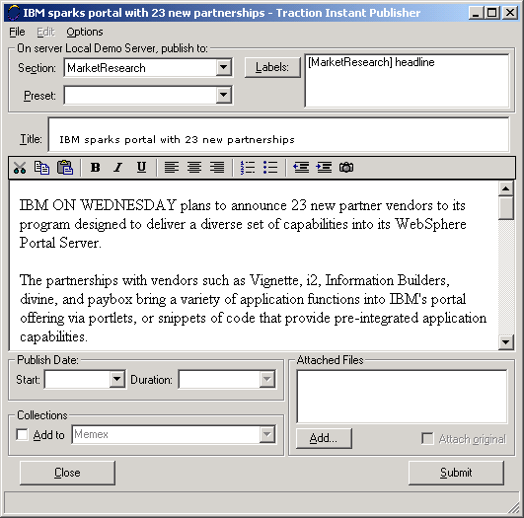
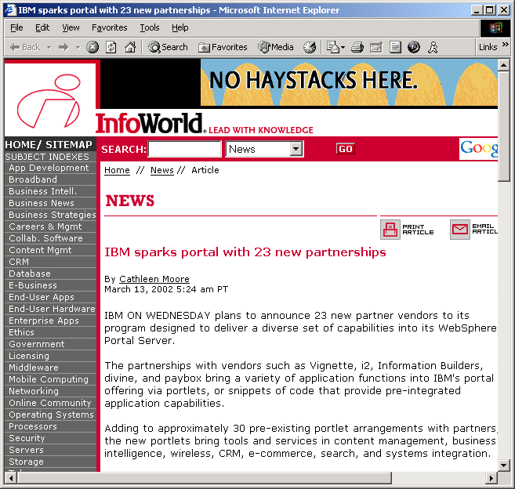
Discover and Collect
Find or write relevant information, publish with Traction Instant Publisher

Slide 23
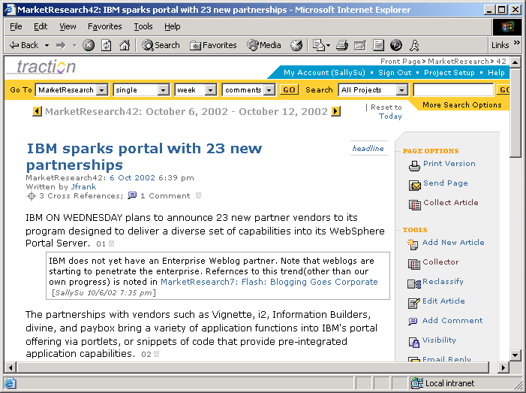
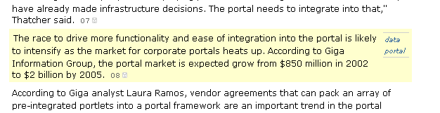
Comment and Label
Comments leverage the reading experience for the whole organization.
Apply comments to note relevant industry trends
Add links to related articles within article or comment
Apply labels like “portal” and “data” to call out facts and speed later retrieval

Slide 24
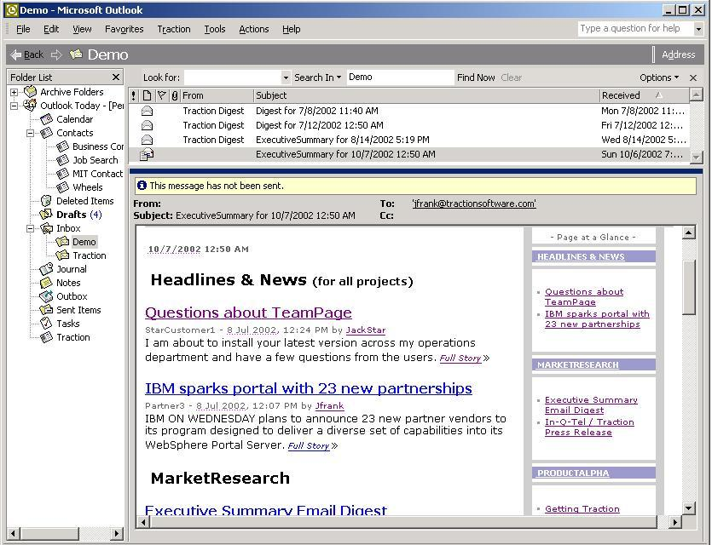
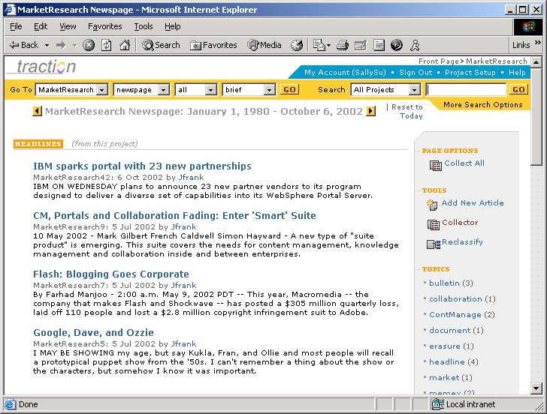
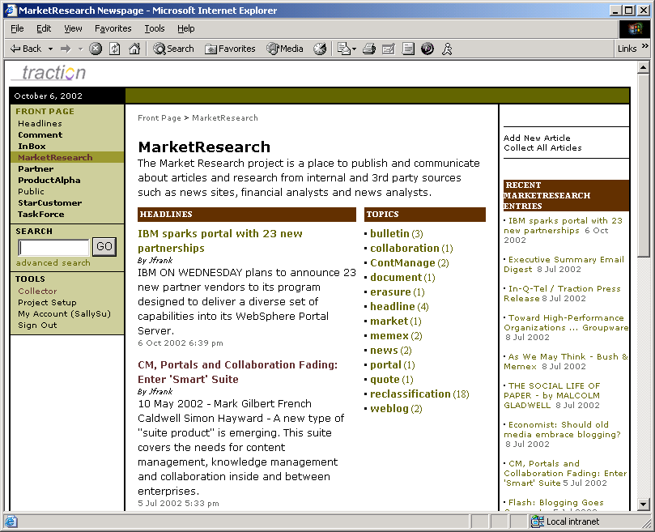
Publish to News Page and Executive Summary email
Traction publishes to Market Research News Page and article summary is distributed in Executive Summary email newsletter.

Slide 25
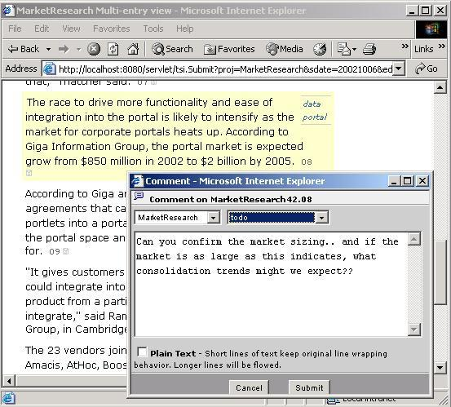
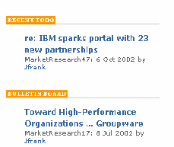
Reader Asks a Question
Reader clicks through email
Asks a question on paragraph
Applies “To Do” label
“To Do” appears on News Page

Slide 26
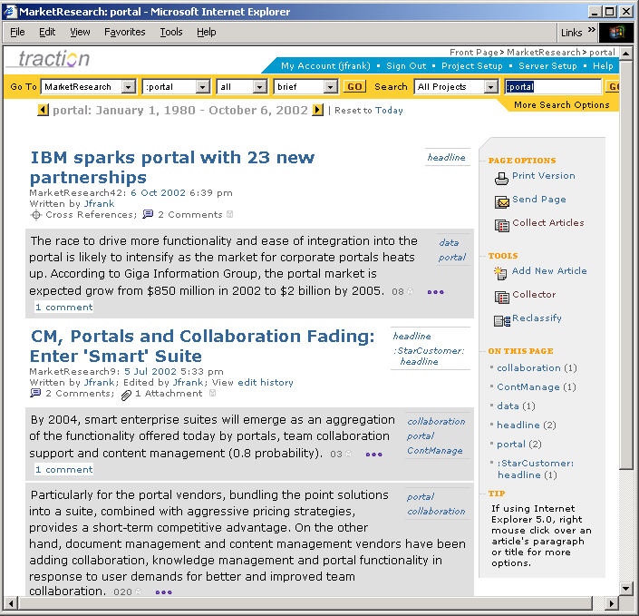
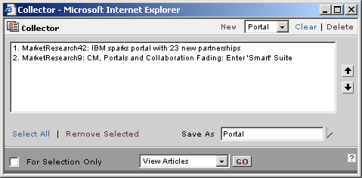
Research Response (1 of 2)
Researcher searches for all articles with the “portal” label
Traction displays articles in Brief view
Researcher captures references in Traction Collector

Slide 27
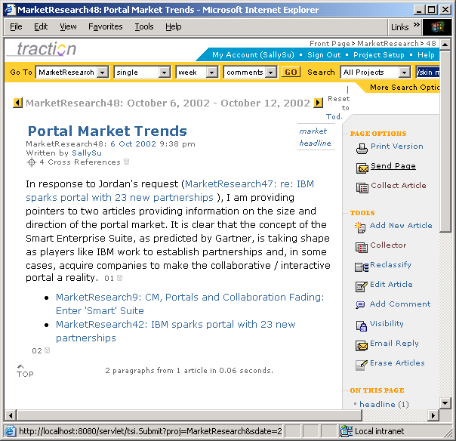
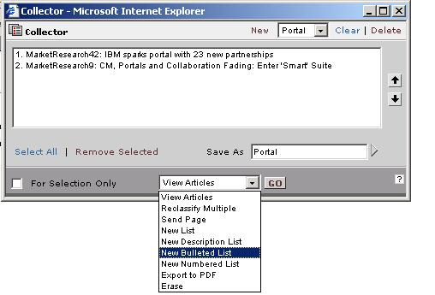
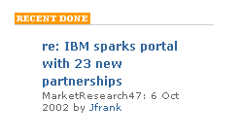
Research Response (2 of 2)
A new bulleted list is created from the Collector
Research response is written and published
And marked Done on the project News Page

Slide 28
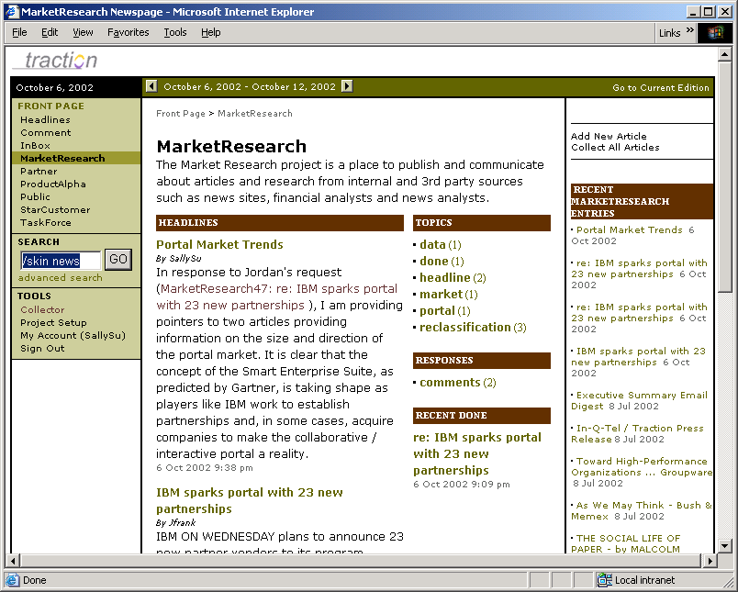
Notification
Readers learn about the response by:
Email to the person who asked the question, directly from Traction
Executive Summary email
Traction Front Page / News Page
Recent Entries sidebar
Traction generated PDF briefing book

Slide 29
Connecting to other Teams
Flag information into TeamPage projects for downstream teams
Traction becomes a communication hub for:
  Exception reporting and key action tracking
  Strategic planning
  White papers
  Program or Product Management
  Engineering
  Customer account teams
  First responders and warfighters (ops log)

Slide 30
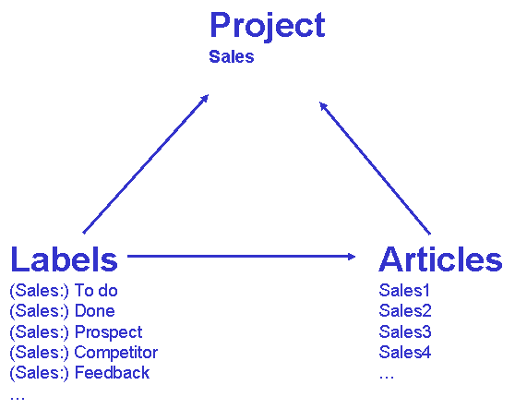
How is Traction structured?
Journal
By Project
  By Label
  Labels belong to projects
Projects are permissioned spaces for
  Group of people (i.e. Board)
  Subject of Interest (i.e. Market Research)
  Temporal Project (i.e. ProductAlpha)
Project permissions include
  Write, Read, Apply label, Define label, Erase

Slide 31
Example: Sales Project
Project
Sales
Labels
To do
Done
Prospect
Competitor
Feedback
…
Articles
1
2
3
4
…

Slide 32
Labels Belong to Projects
Project
Sales
Labels
(Sales:) To do
(Sales:) Done
(Sales:) Prospect
(Sales:) Competitor
(Sales:) Feedback
…
Articles
1
2
3
4
…

Slide 33
Articles Belong to Projects
Project
Sales
Labels
(Sales:) To do
(Sales:) Done
(Sales:) Prospect
(Sales:) Competitor
(Sales:) Feedback
…
Articles
Sales1
Sales2
Sales3
Sales4
…

Slide 34
Labels are applied to Articles
Project
Sales
Labels
(Sales:) To do
(Sales:) Done
(Sales:) Prospect
(Sales:) Competitor
(Sales:) Feedback
…
Articles
Sales1
Sales2
Sales3
Sales4
…

Slide 35
Any number of Labels can be applied to an Article
(paragraph grain)
Project
Sales
Labels
(Sales:) To do
(Sales:) Done
(Sales:) Prospect
(Sales:) Competitor
(Sales:) Feedback
…
Articles
Sales1
First paragraph…
Second paragraph…
Sales2
Sales3
Sales4
…

Slide 36
Articles can cite each other
(Links are bi-directional)
Project
Sales
Labels
(Sales:) To do
(Sales:) Done
(Sales:) Prospect
(Sales:) Competitor
(Sales:) Feedback
…
Articles
Sales1: Notes from Meeting
…
Sales2: Follow-up from meeting
… see Sales1: Notes from meeting for
the attendees…

Slide 37
Citations can cross Projects
Project
Marketing
Project
Sales
Labels
(Marketing:) To do
(Marketing :) Done
(Marketing :) Suggestion
…
Articles
Marketing1: Cutting advertising costs
…
Marketing2: Customer suggestions from survey
…also see Sales1: Notes from meeting for more suggestions…
Labels
(Sales:) To do
(Sales:) Done
(Sales:) Prospect
(Sales:) Competitor
(Sales:) Feedback
…
Articles
Sales1: Notes from Meeting
…
Sales2: Follow-up from meeting
… see Sales1: Notes from meeting for
the attendees…

Slide 38
Labels from different Projects can be applied to the same Article
Project
Marketing
Project
Sales
Labels
(Marketing:) To do
(Marketing :) Done
(Marketing :) Suggestion
…
Articles
Marketing1: Cutting advertising costs
…
Marketing2: Customer suggestions from survey
…also see Sales1: Notes from meeting for more suggestions…
Labels
(Sales:) To do
(Sales:) Done
(Sales:) Prospect
(Sales:) Competitor
(Sales:) Feedback
…
Articles
Sales1: Notes from Meeting
…
Sales2: Follow-up from meeting
… see Sales1: Notes from meeting for
the attendees…

Slide 39
Projects control permissions
Cross-project labels extend visibility across Projects
Project
Marketing
Visible to Sales
Project
Sales
Labels
(Marketing:) To do
(Marketing :) Done
(Marketing :) Suggestion
…
Articles
Marketing1: Cutting advertising costs
…
Marketing2: Customer suggestions from survey
…also see Sales1: Notes from meeting for more suggestions…
Labels
(Sales:) To do
(Sales:) Done
(Sales:) Prospect
(Sales:) Competitor
(Sales:) Feedback
…
Articles
Sales1: Notes from Meeting
…
Sales2: Follow-up from meeting
… see Sales1: Notes from meeting for
the attendees…
Visible to Marketing

Slide 40
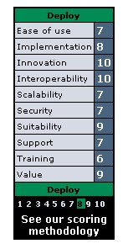

Product Review
TeamPage™ Launch
“Deploy”
rating
July 12, 2002 – “Getting Traction” by Jon Udell
This powerful and easy-to-deploy Java-based KM server converts e-mail, Web content, and Office documents into an XML database that can be reorganized and searched.

